Slide 1
Zero-Downtime deployments with Kubernetes
Mateusz Dymiński
Nokia

Slide 2
Whoami
Mateusz Dymiński
Software Developer at Nokia
8+ exp with Java
4+ exp with Go
One of the organizer GoWroc - Golang Wroclaw Meetup
Github: github.com/mateuszdyminski
Twitter: @m_dyminski
LinkedIn: linkedin.com/in/mdyminski

Slide 3
Agenda
Zero Downtime Deployment
Definition
Types
Graceful Shutdown
Definition
Connection Draining
HTTP Keep-Alive
Java
SIGTERM
Jetty
Spring
Kubernetes
Kubernetes features
Rolling Update
Readiness Probe
HTTP
Command Line Scripts
TCP Socket
Demo
Summary / Best Practices
In Java
In Kubernetes

Slide 4
github.com/mateuszdyminski/zero

Slide 5


Slide 6
What is this zero downtime deployment?
Deploy application to production
End user can’t notice any errors/problems during the deployment
Monitoring tools shouldn’t even notice that deployment is ongoing/done
Bugs can be fixed without any outage.
New features can be introduced without any outage.
Required for Continuous Delivery - CD

Slide 7
Zero downtime deployment types
Blue/Green deployment
Rolling Updates deployment
Canary deployment

Slide 8
Blue Green Deployment
A blue-green deployment is when you run two complete deployments of your application.
A deployment that is currently in production, and a deployment with the changes you want to introduce.
Have proxy or load balancer in front of your applications
Switch traffic to the new deployment when you are ready to take your changes into production.

Slide 9
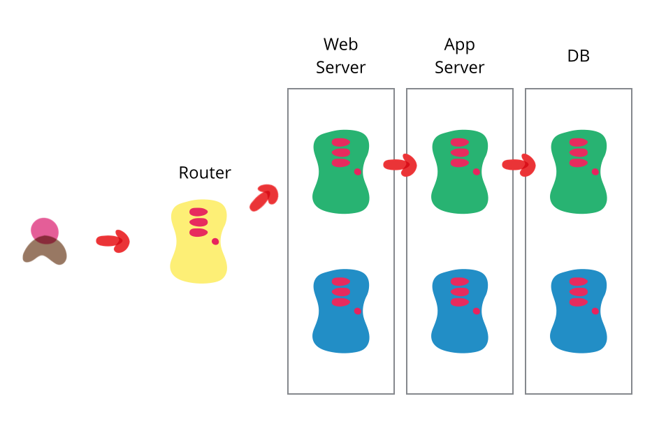
Blue Green Deployment
Source: https://martinfowler.com/bliki/BlueGreenDeployment.html

Slide 10

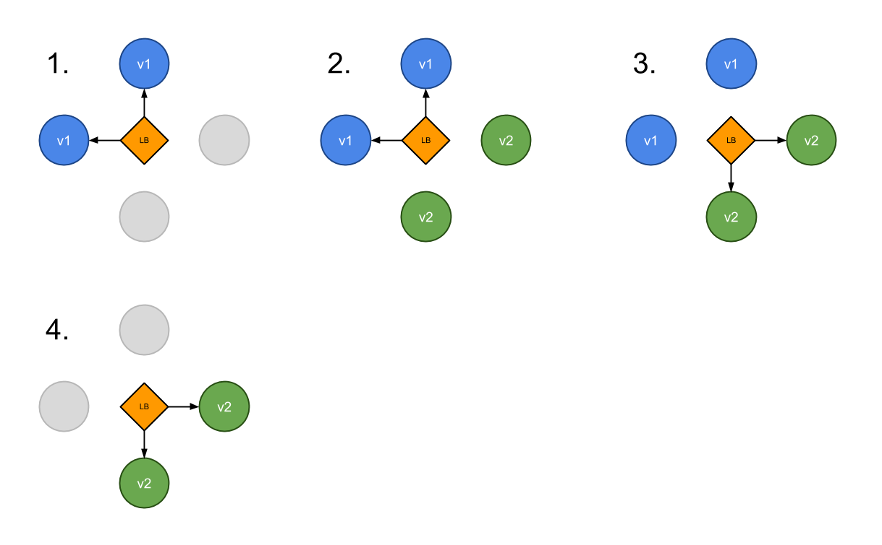
Blue Green Deployment

Slide 11
Rolling Update Deployment
Rolling Update deployment is when you run new version of the application next to the old one
Have proxy or load balancer in front of your applications
One by one new application is deployed and old one is shutdown
Problem – client needs handle old and new application in the same time

Slide 12
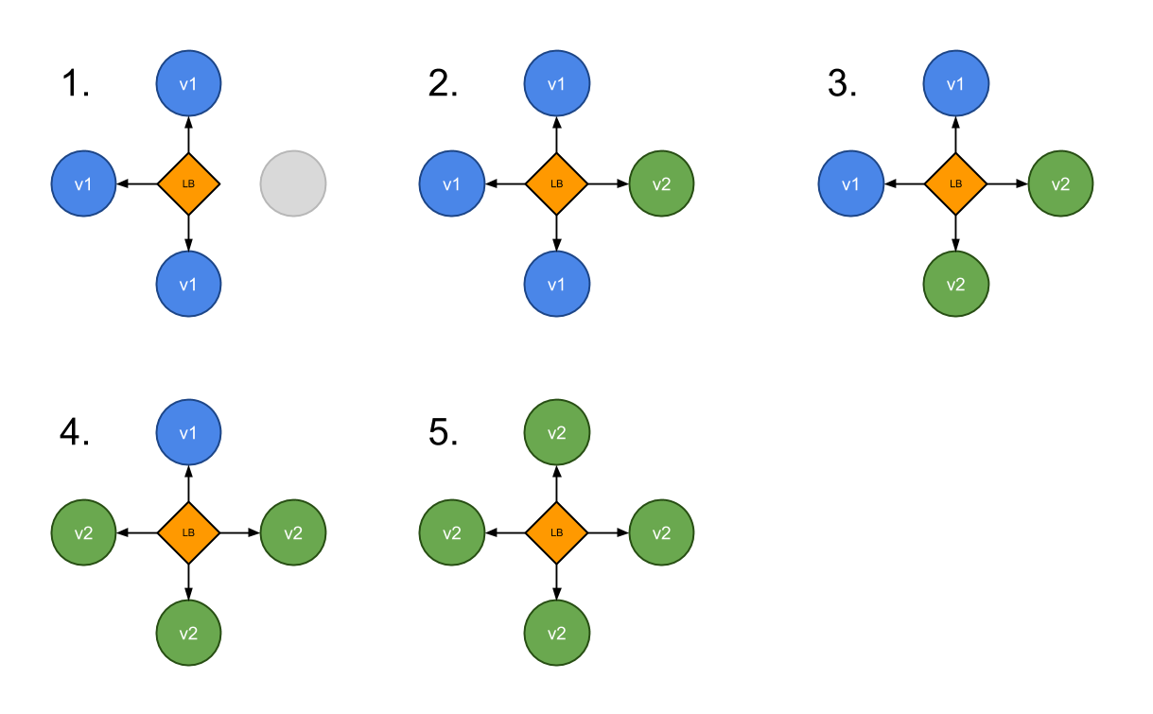
Rolling Update Deployment

Slide 13
Canary Deployment
Canary deployment is when you run new version of the application next to the old one
Have proxy or load balancer in front of your applications
Some new applications are deployed next to the old ones
Part of the traffic is moved to the new application based on some rules – random, weight, cookie, http header etc.
Problem – client needs handle old and new application in the same time

Slide 14
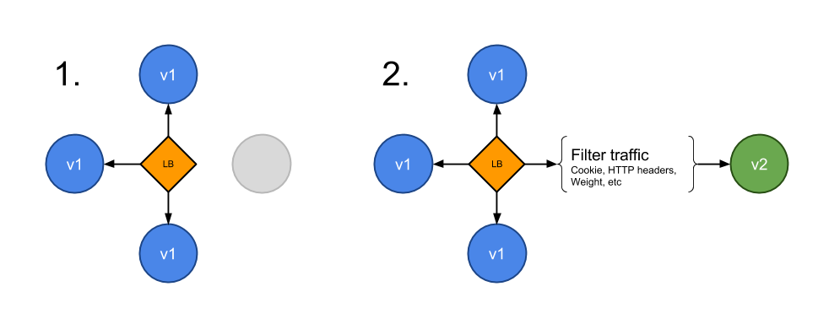
Canary Deployment

Slide 15
Graceful Shutdown

Slide 16
Graceful Shutdown
We can speak about the graceful shutdown of our application, when all of the resources it used and all of the traffic and/or data processing what it handled are closed and released properly.
It means that no database connection remains open and no ongoing request fails because we stop our application.

Slide 17
Scenario for a graceful web server shutdown
App gets notification to stop (received SIGTERM)
App lets know the load balancer that it’s not ready for newer requests
App served all the ongoing requests
App releases all of the resources correctly: DB, queue, etc.
App exits with "success" status code - usually ”0” - zero

Slide 18
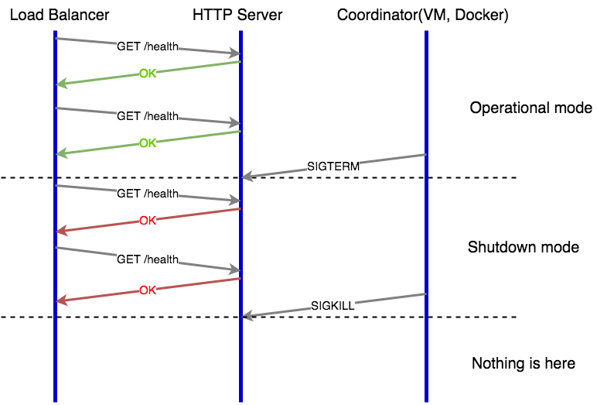
Web Server Graceful Shutdown

Slide 19
Who of you hears about Kubernetes?
Who of you play with Kubernetes?
Who of you is using Kubernetes on production?

Slide 20

Kubernetes

Slide 21
Kubernetes
Open source platform that automates Linux container operations.
Eliminates many of the manual processes involved in deploying and scaling containerized applications.
Groups hosts running Linux containers
Kubernetes helps you easily and efficiently manage those clusters.
These clusters can span hosts across public, private, or hybrid clouds

Slide 22
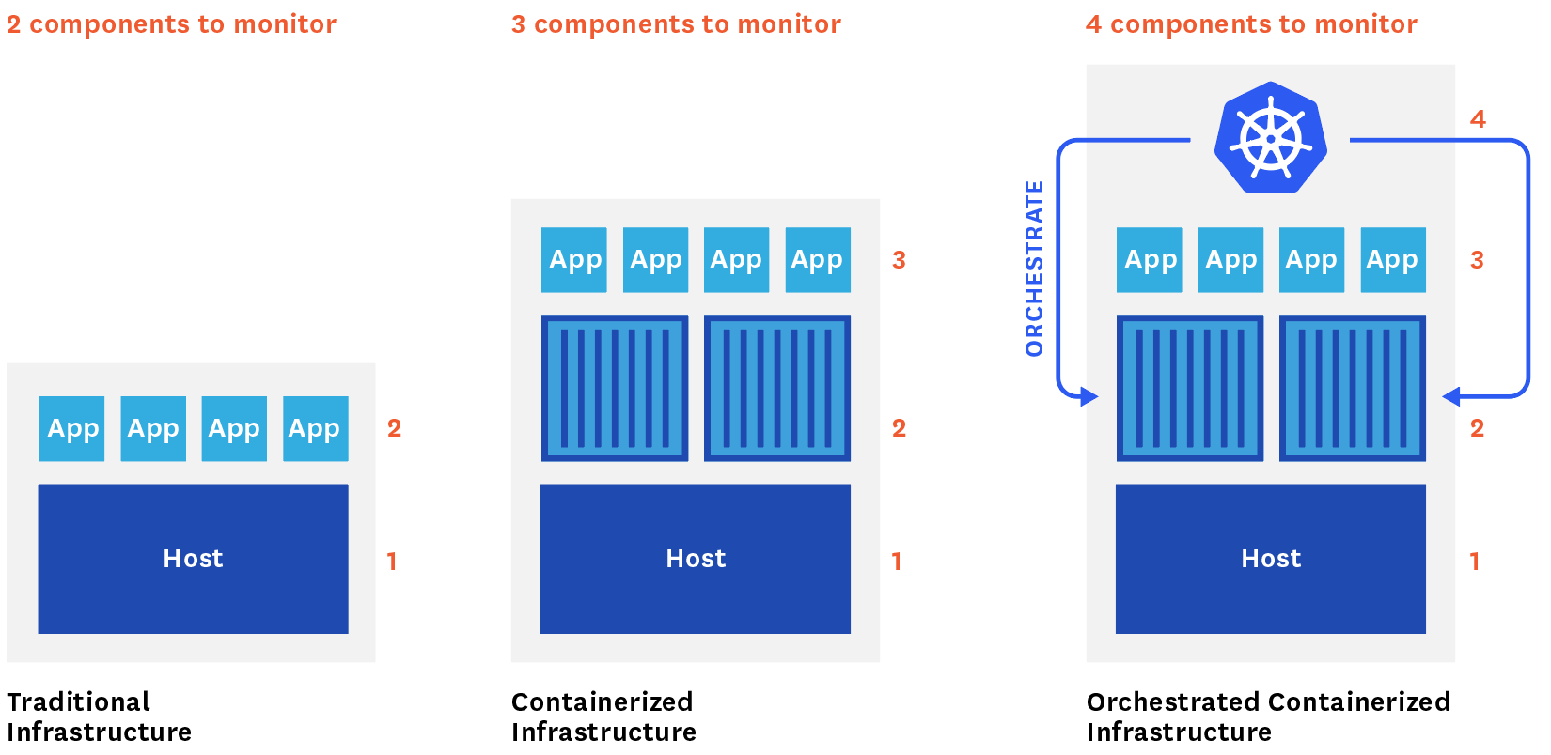

Slide 23
Why Kubernetes
Orchestrate containers across multiple hosts.
Make better use of hardware to maximize resources needed to run your enterprise apps.
Control and automate application deployments and updates.
Mount and add storage to run stateful apps.
Scale containerized applications and their resources on the fly.
Declaratively manage services, which guarantees the deployed applications are always running how you deployed them.
Health-check and self-heal your apps with autoplacement, autorestart, autoreplication, and autoscaling.

Slide 24
Demo

Slide 25
Demo Application

Slide 26
Demo Application
Users Service
REST API
Storage: MySQL

Slide 27
User
@Entity @Table(name = "users") public class User { @Id @GeneratedValue(strategy = GenerationType.IDENTITY) private Integer id; private String firstName; private String secondName; @Temporal(TemporalType.TIMESTAMP) private Date birthDate; public Integer getId() { return id; } public String getFirstName() { return firstName; } public String getSecondName() { return secondName; } public Date getBirthDate() { return birthDate; } }

Slide 28
Users Controller
@RestController @RequestMapping("/api") public class UsersController { @Autowired UserRepository userRepository; @GetMapping("/users") public List<User> getAllUsers() { return userRepository.findAll(); } @PostMapping("/users") public User createUser(@Valid @RequestBody User user) { return userRepository.save(user); } @GetMapping("/users/{id}") public User getUserById(@PathVariable(value = "id") Integer userId) { return userRepository.findById(userId) .orElseThrow(() -> new ResourceNotFoundException("User", "id", userId)); } }

Slide 29
Demo Users Service
Build Users Service
Run
$ mvn package
$ java -jar target/users-1.0.0.jar

Slide 31


Slide 32
Thank you!

